Slide 1
Data Link Layer
Vidhi Pandya
Assistant Professor
CSE Department
DEPSTAR
CHARUSAT

Slide 2
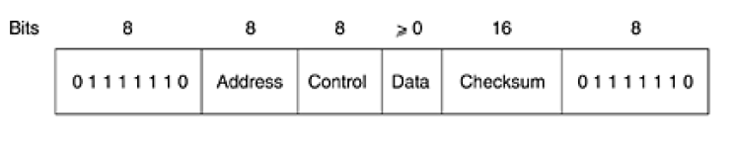
HDLC
High-Level Data Link Control Protocol
Bit oriented – use bit stuffing for transparency
Frame Format for bit oriented protocols
Checksum – CRC
Total – 32 bits

Slide 3
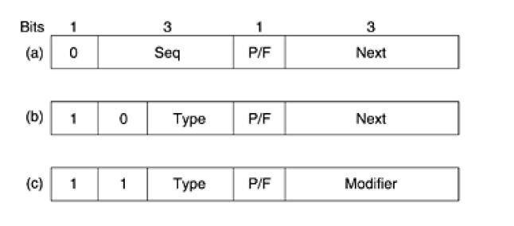
Types of Frame
Information Frame
Supervisory Frame
Unnumbered Frame
Seq –> Sequence Number – 3bits – 0 to 7
P/F –> P – Poll & F – Final
Next -> Next Frame
Type -> o – Receiver Ready (ack)
1 – Reject (Transmission Error)
2 – Receive Not Ready (Temp Prob)
3 – Selective Reject (force Retrans)

